Slide 1
Genetic Algorithms
Sergey Ovchinnik
for compsockent and AI society

Slide 2
In this session
Optimisation Problems
Simple trial and error
Evolutionary approach to optimisation
Genetic algorithm basics
Some advanced topics

Slide 3
Optimisation problems
Some computational problems have many different solutions
  Path finding on a map
  Traveling salesman
  Knapsack problem
  Scheduling events
  Game strategies
  etc.

Slide 4
What is an optimisation problem
A problem that has many correct solutions
Some solutions are better than others
  Shorter paths
  Bigger knapsacks
  Less conflicting schedules
  Higher scoring game strategies

Slide 5
How to solve optimisation problems
We need:
A way to decide which solutions are valid
A way to decide which solutions are better
  Ideally a numerical measure
A simple algorithm that will try solutions and find the best one

Slide 6
Monte Carlo algorithm
An algorithm that tries different random solutions
Keeps track of the best one it has seen
Let’s program one...

Slide 7
Monte Carlo algorithm
Good as a baseline solution
Very easy to make
Not particularly strong for larger problems

Slide 8
Evolutionary approach
In nature, populations of species evolve over time to adapt to changing environments
A population of somewhat random individuals
Survival of the fittest
Sounds familiar

Slide 9
Evolution and reproduction
The main evolutionary drive is ability to reproduce
Your genes will be more prevalent in the population if you reproduce more
So fitness in nature is largely related to reproductive performance
And survival, of course

Slide 10
Using evolution to solve optimisation problems
We can run an evolutionary process over a number of generations
We can define fitness for individuals and make fitter ones more likely to reproduce
We can define reproduction as well, using data from two parent solutions to form a new child solution

Slide 11
Summary of what we need
Generation function
  To generate new solutions
Fitness function
  To evaluate solutions
Selection function
  To select which ones get to breed
Crossover function
  To breed solutions together
Generations loop

Slide 12
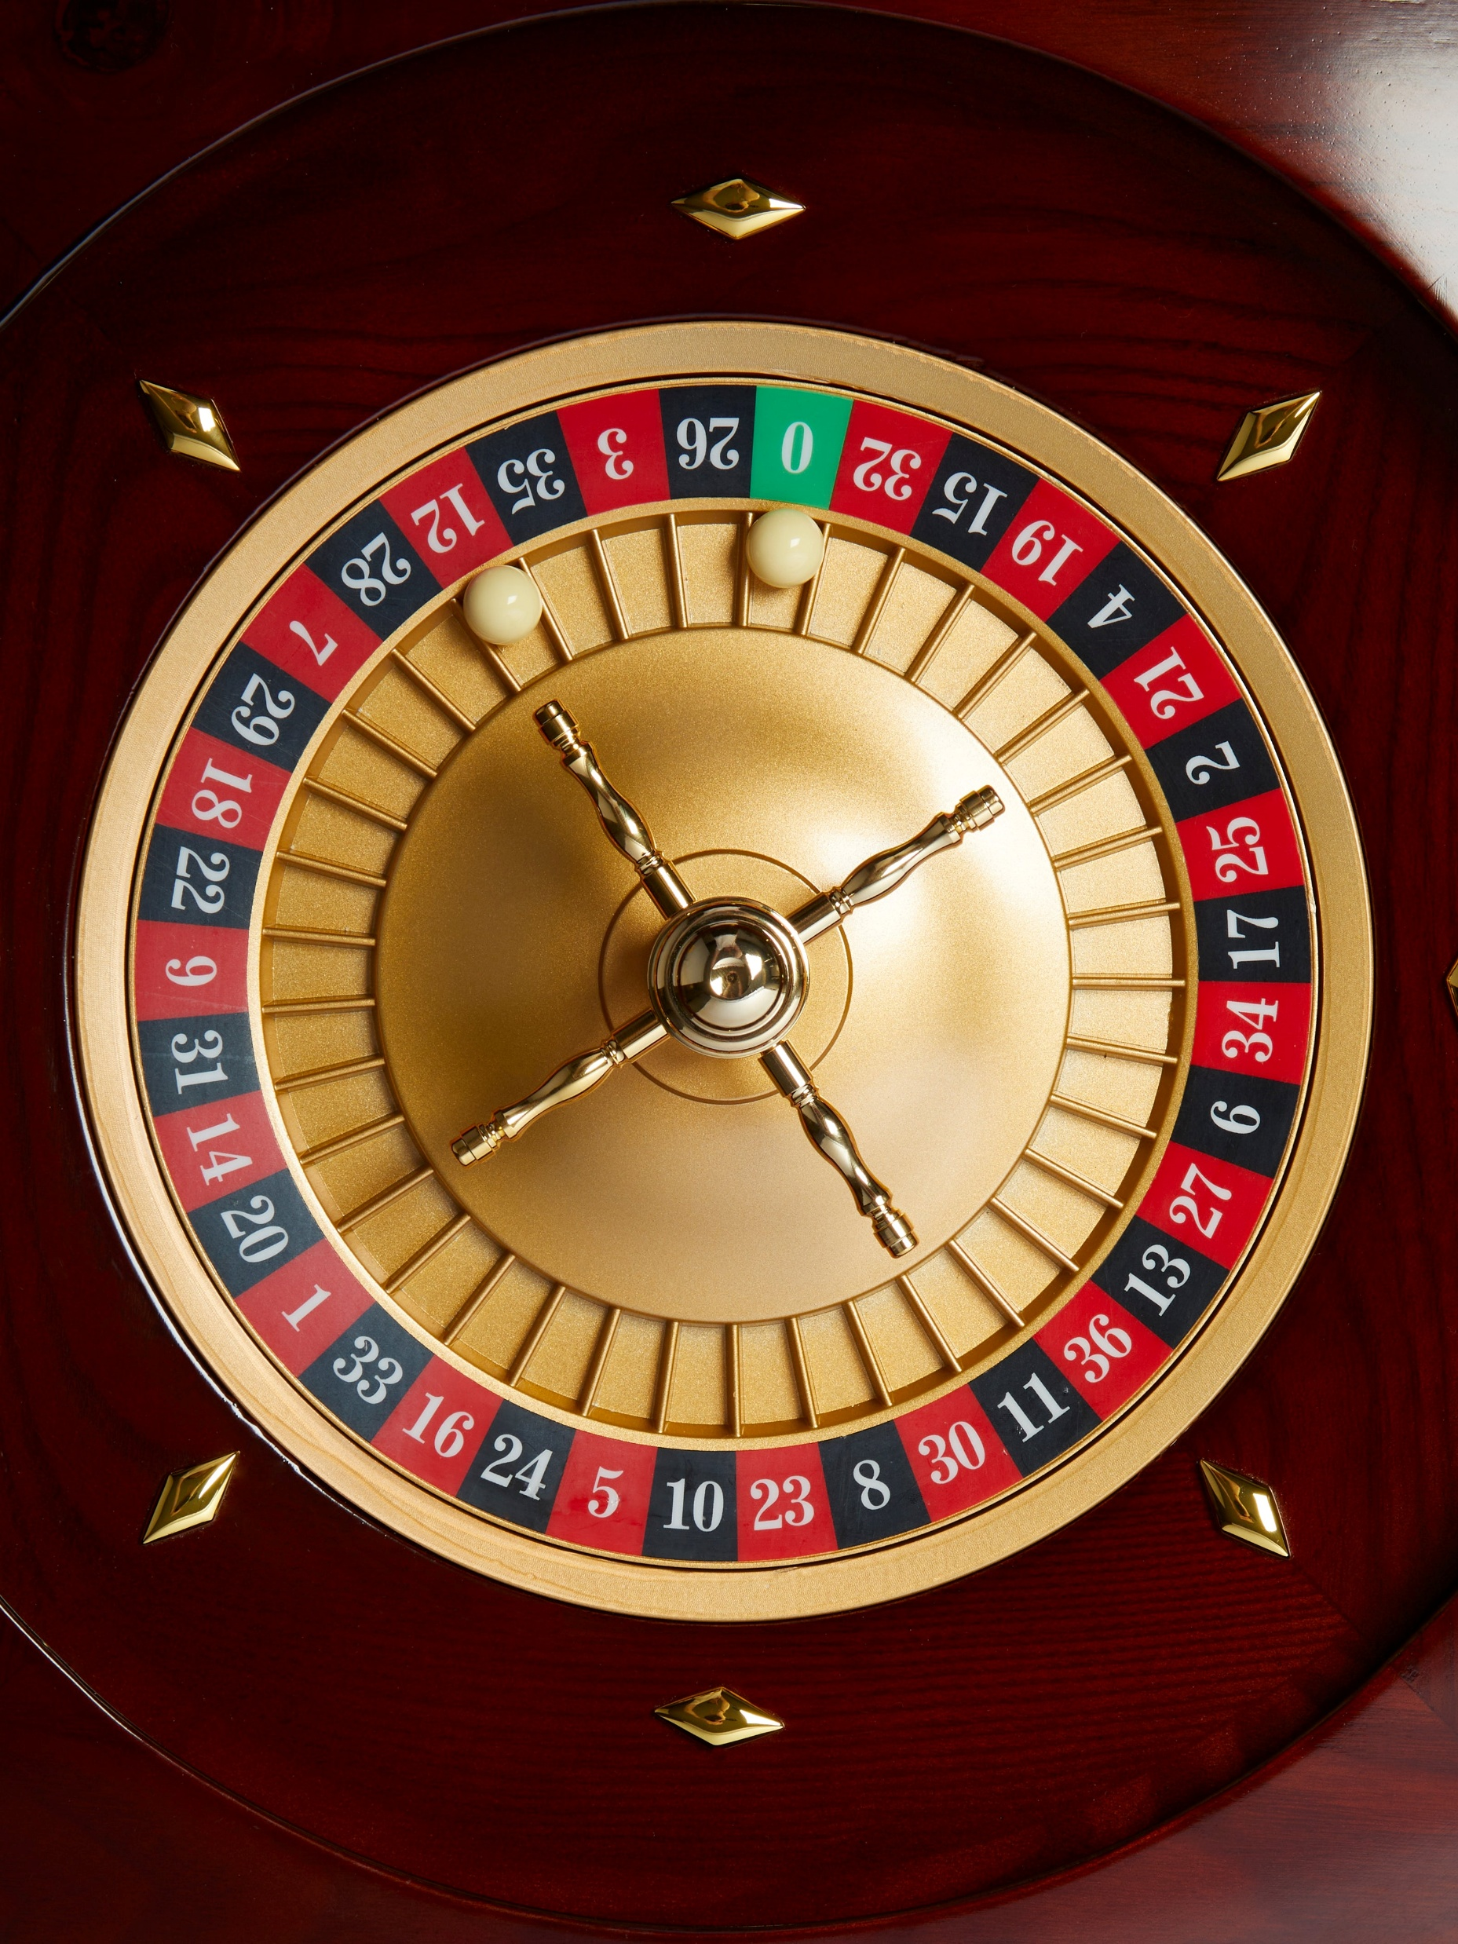
Roulette wheel selection
A common selection method is roulette wheel
Imagine a roulette wheel with sectors
Some sectors are wider, so more likely to be picked
We do the same with individual solutions and width of a sector is equal to the fitness

Slide 13
Let’s code
Let’s make our Monte Carlo solution run through several generations
First one is still randomly generated
Then we breed individuals to create children for the next generation
Repeat until they evolve

Slide 14
Extra topic: Mutation
In real life breeding, genes are generally copied from parents
But sometimes mutations occur due to faulty copying
So the child can have unique genes not present in either of its parents
We can add a Mutation Function to slightly mutate children after crossover, with a small probability

Slide 15
Extra topic: Elitism
In real life evolution, generations die out completely after some time, meaning that some great individuals are lost forever
In artificial evolution we can keep them alive for longer
We can do this by keeping a few really good individuals around between generations
So next generation will include the best members of the current one

Slide 16
Extra topic: Re-generation
As the population evolves, it will likely converge to one solution
So it won’t be able to explore other solutions anymore
We can solve it by creating some new individuals using our generation function and allow them to participate in breeding
Makes the algorithm noisier but mitigates premature convergence

Slide 17
Let’s program these in
We will copy over some of the best individuals from each generation to the next generation to preserve the elites
We will re-generate some individuals to enforce diversity
We will introduce a chance that a child will mutate

Slide 18
Summary
Generations loop to run evolution
Generation function to create individuals
Fitness function to evaluate them
Selection function to select individual for breeding
Crossover function to perform breeding
Mutation function to increase randomness
Elitism and re-generation to preserve good solutions and enforce diversity

